Slide 1
The Battle of Neighborhoods The Electric Vehicle City
A capstone project report presented for the requirements of the Coursera Applied Data Science Professional Certificate
SUBMITTED BY MUHAMMAD DANIAL AFIQ BIN ABDULLAH

Slide 2
Content Page
1 Introduction
1.1 Background
1.2 Aim
1.3 Data
2 Methodology
2.1 Data Cleaning
2.1.1 Car Data
2.1.2 Oslo EV Station Location Data
2.1.3 Singapore EV Charging Station Location Data
2.2 Feature Selection
3 Exploratory Data Analysis
3.1 Car Population Singapore vs Oslo
3.2 Electric Vehicle charging stations
4 Predictive Modelling
4.1 Oslo Venue Analyzation
4.1.1 Oslo Clusters
4.2 Singapore Venue Analysis
4.2.1 Singapore Cluster
5 Conclusion

Slide 3
1 Introduction
1.1 Background
Climate change is no longer an issue that can be ignored.
The effects of Greenhouse emissions as a byproduct of modernization is known to be the main source of the problem.
The Paris Agreement, Accord de ParisThe agreement within the United Nations Framework Convention on Climate Change (UNFCCC) was signed in 2016.
a long-term goal to keep the increase in global average temperature to well below 2°C above pre-industrial levels
to limit the increase to 1.5°C, since this would substantially reduce the risks and effects of climate change.
detailed analysis using the abundant volume of data analysis is required to target areas of industry or lifestyle that can be changed in order to make significant impact.

Slide 4
1 Introduction
1.2 Aim
use location data provided by Foursquare to determine the best locations for EV charging stations in the city of Singapore.
Using location data from Oslo, Norway, analysis can be done to determine if there are determining factors that would make ideal locations.
Used by governments, vehicle manufacturers as well as service providers to strategically plan for the coming disruption of transportation trends in different cities.

Slide 5
1 Introduction
1.3 Data
Location data will be obtained from Foursquare.
The Singapore vehicle population number is obtained from data.gov.sg
Vehicle population data for the city of Oslo, Norway is obtained from Statistics Norway (ssb.no).

Slide 6
2 Methodology
Based on definition of our problem, factors that will influence our decisions are:
number of existing petrol cars and electric cars there are both in Oslo, Norway as well as Singapore
number of EV charging stations
locations surrounding current EV Charging stations within Oslo
clusters where EV charging stations can be placed in Singapore using supervised Machine Learning k-cluster algorithm.
Following data sources will be needed to extract/generate the required information:
number of EV charging stations and their type and location surrounding every charging station will be obtained using Foursquare API
coordinates of charging stations using OpenStreetMap Nominatim: Search

Slide 7
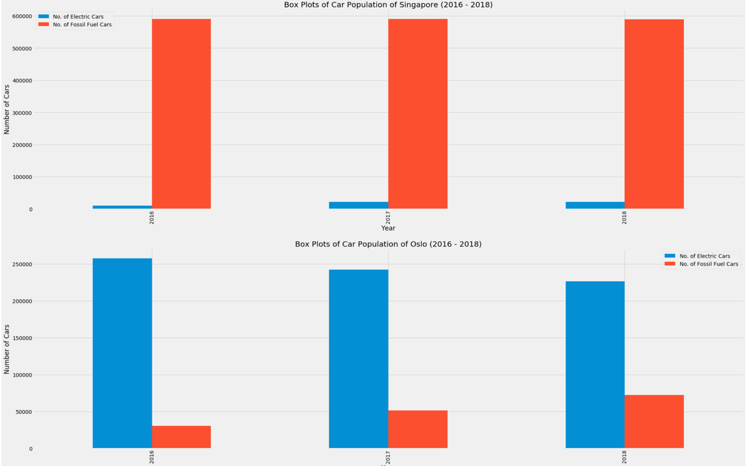
3 Exploratory Data Analysis
Car Population Singapore vs Oslo

Slide 8
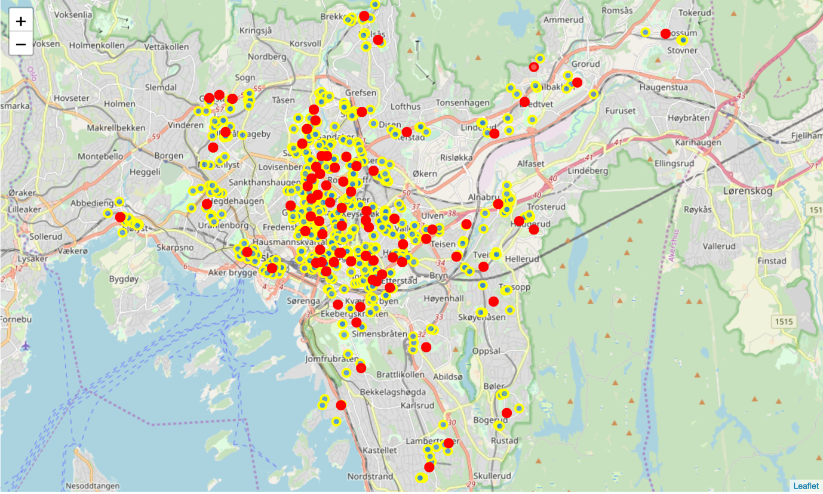
3.2 Electric Vehicle charging stations and Venues, Oslo
In Oslo, there 200 known EV charging stations (EVCS) as compared to Singapore’s 24.
not surprising given that these stations cater to the needs of the far greater number of electric cars in their city.
Mapping current EVCS in Oslo and the locations surrounding it would give us a visual representation of how the stations are spread out or strategically placed.

Slide 9
3.3 Electric Vehicle charging stations and Venues, Singapore
map of Singapore neighborhoods and the relevant venues surrounding them.
The spots in red are the current EV charging stations in Singapore.
Majority are from a single car sharing electric vehicle BlueSG to serve customers who use the company’s vehicle and services

Slide 10
4 Predictive Modelling
The chosen predictive model used in this analysis is k-means clustering.
Using the explore function, the most common venue categories in each neighborhood are determined
using these features to group the neighborhoods into clusters using k-means cluster algorithms.

Slide 11
4.1 Oslo Venue Analyzation
The Oslo venues surrounding each station are grouped by venue type.
A function is used to rank the venues into top 10 most common venues.
These venues are then run through the k-means cluster algorithm with a setting of 5 clusters.
These clusters are then inserted into the table with listed charging stations to determine their cluster category.
Folium is then used to visualize their cluster.

Slide 12
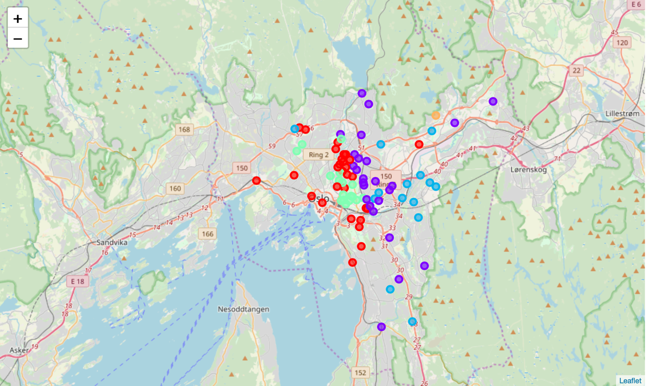
4.1 Oslo Venue Visualisation
The markers in red are the location of charging stations.

Slide 13
4.1.1 Oslo Clusters
Cluster 0 (Red)
Cluster zero is made of venues that are meant for sports activities such as Gym, Soccer Field and Athletics & Sports.
This cluster are also surrounded with a wide variety of bars, cafes and restaurants.
The charging station is strategically placed to serve the needs of Gym goers and those who do sports.
Cluster 1(Purple)
Cluster 1 has the 1st common venue for all charging stations in the cluster as Grocery stores.
The EV stations there are strategically placed for commuters who enter these cluster locations for groceries.
Cluster 2 (cyan blue)
Cluster two is located close to Bus stations and metros.
Surrounding this convenient and accessible locations are food and beverage establishments, malls and areas of leisurely activity.
These areas will see high daily traffic as such drivers with EV can conveniently charge their vehicle whilst running errands or shopping.

Slide 14
4.1.1 Oslo Clusters
Cluster 3 (green)
Cluster 3 is a location filled with a variety of food and beverage establishments.
These are areas people visit for meals and gatherings.
Strategically EV charging stations can serve commuters needs as they frequent such cluster locations.
Cluster 4 (orange)
Cluster 4 has a single station which serves primarily the crowds that go to the soccer stadium.
Since games are hosted on weekends the peak periods are presumably on weekends as such a single station should suffice the neighbourhood’s needs.
Grocery store shoppers who live in that area have the station to depend on as well.

Slide 15
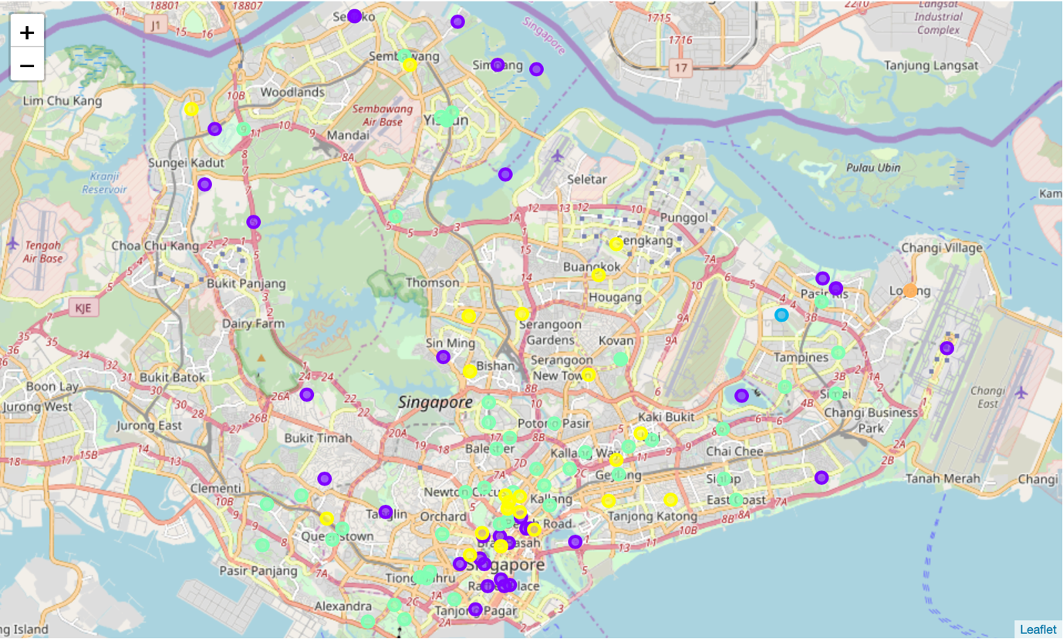
4.2 Singapore Venue Analysis and Visualisation
Similar ranking and k-cluster algorithms were done on Singapore venue data sets however these venues are surrounding neighborhoods in Singapore.

Slide 16
4.2.1 Singapore Cluster
Cluster 0
Cluster zero is the farming area of Singapore
This cluster has no charging stations for EV cars due to its isolated location.
Should Singapore convert their delivery trucks to and from the farms to electric, this cluster could be a potential area for installation.
Just like in Oslo where the single cluster (cluster 4) with the stadium has a single electric charging station, this particular structure could use at least 1.
Cluster 1(Purple)
In cluster 1, the cluster includes multiple hotels and amenities for tourists.
The area is surrounded with food and beverage establishments.
Pharmacies, gyms and shopping centers are located within this cluster.
BlueSG has strategically placed multiple stations here for ride sharing purposes.
Should ride sharing companies enter the competition with EV cars, this cluster should be the focus.
This cluster is similar to Oslo's cluster 3 where there are multiple restaurants which is a proven case where larger numbers of charging stations can be focused.

Slide 17
4.2.1 Singapore Cluster
Cluster 2 (cyan blue)
Cluster 2 is a cluster with a football stadium and Yoga Studio which stands out the most.
These locations have restaurants and eateries to meet the needs of physical activities.
The East location has 0 EV charging stations and the least represented in Singapore.
These towns have parks and beaches which would promote lesser car use and are popular bicycle towns.
To improve the environment in that area promotion of electric cars and the installation of more charging stations within park and beach areas.
Cluster 3 (green)
Cluster 3 are areas with eateries and restaurants.
These locations are food and beverage clusters.
BlueSg has EV stations within these clusters however some areas are underserved however should alternative companies plan to enter the market for more electric cars and stations, these areas could be potential areas for expansion.
Cluster 4 (orange)
Cluster four is a cluster for local delicacies, coffee shops and cafes.
These locations do not have enough stations to serve an increase in electric car increase.
Similar to cluster 3 in Oslo these locations are possible locations to increase charging stations to serve the needs of consumers.

Slide 18
5 Conclusion
Oslo is a proven model city should Singapore choose to adopt electric vehicles.
Other factors that may affect these EVCM locations:
should be placed in widespread locations to avoid traffic jams and congestion
multi story housing apartments, housing areas could be possible locations.
prices of EVs become are more affordable than fossil fuel vehicles.
The number of electrical charging stations should however be an area of further analysis.
many other factors can affect a model of the number of EVCMs required.
GDP
Taxes for such vehicles
COE prices
Governmental legislation

